Slide 1
Travel Website Project
A hobby web app built with python

Slide 2
Technology Stack
Languages and Frameworks we use

Slide 3







Backend
Flask Framework (Python)
MySQL Database
Frontend
HTML
CSS
JavaScript
LeafMap Library
MapQuest Library

Slide 4
Features
Features built in our web app

Slide 5
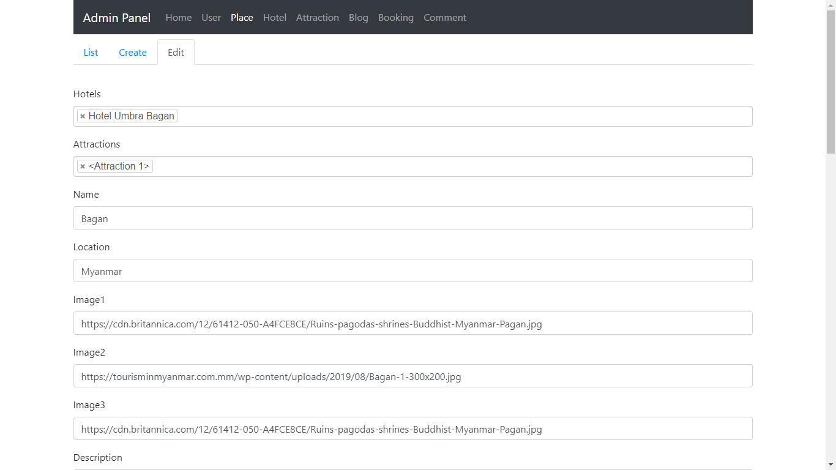
Content Management
Our project supports content management from admin panel. It will make the website much dynamic.

Slide 6
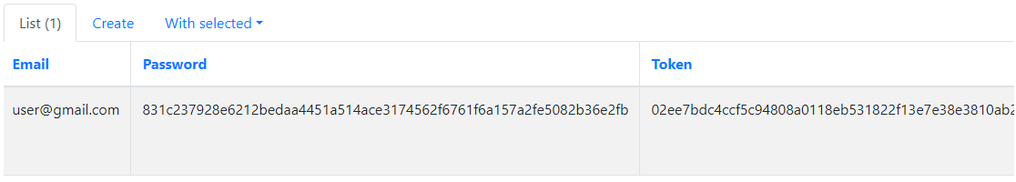
Authentication
Along with token based authentication, users will able to create accounts, login and logout. We use SHA 256 hashing algorithm to generate highly secured token for every user.

Slide 7
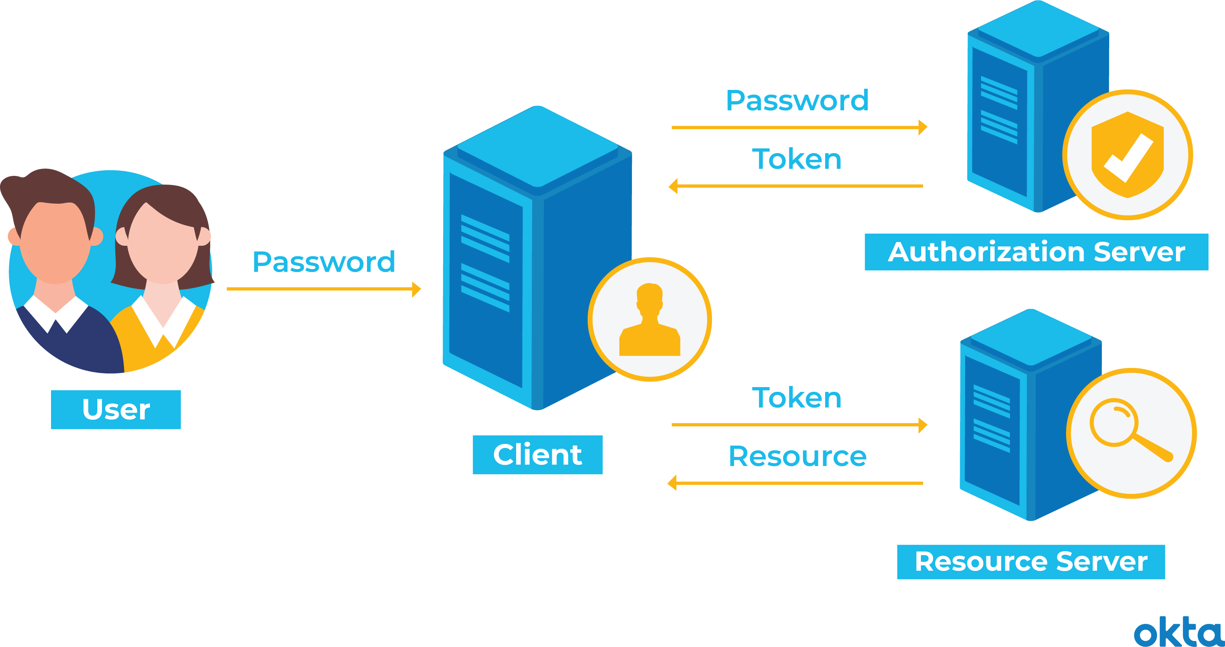
How Authentication Works
See below diagram to see how token authentication works in backend.
In our project, we use single server as authorization and resource server.

Slide 8
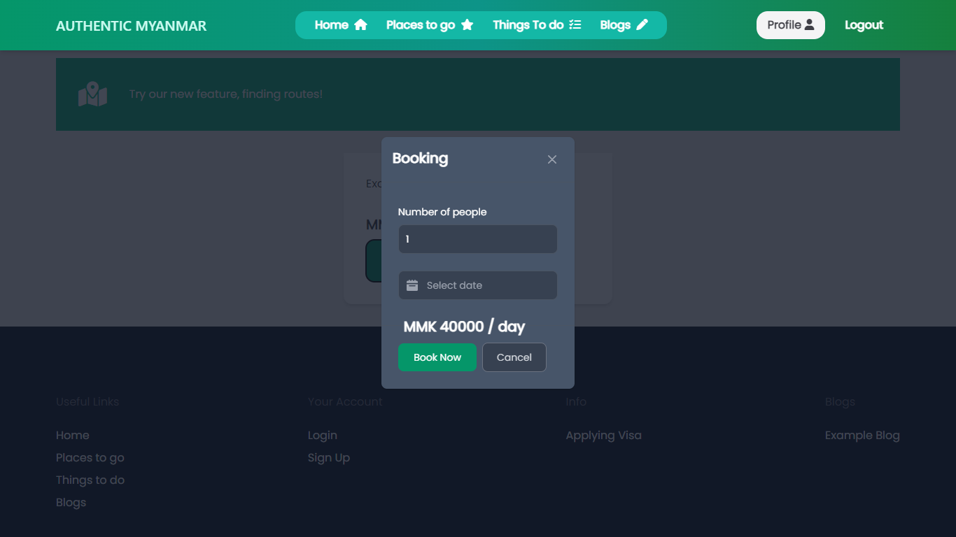
Hotel Bookings
Users will able to submit hotel bookings! And booking data will be stored in MySQL along with other data.

Slide 9
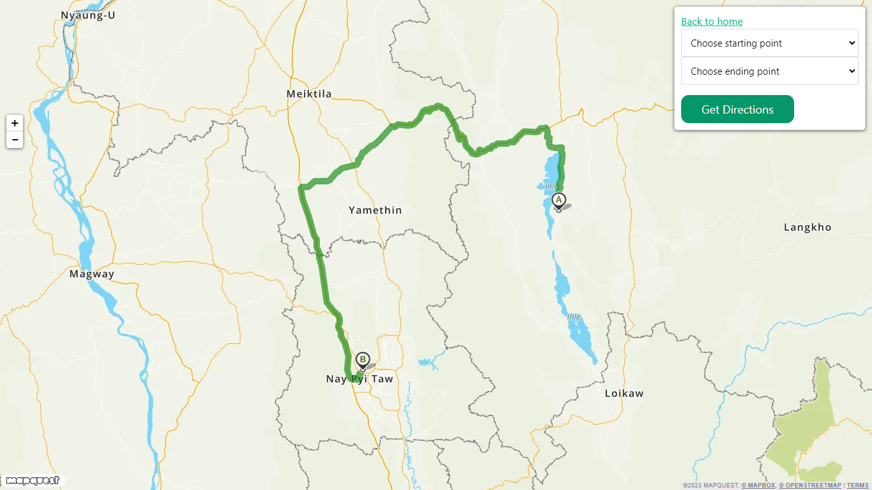
Route Finding
We use Dijkstra's algorithm.
LeafMap and MapQuest are used as libraries for fetching map data.

Slide 10
Project Diagram
Brief flow diagram of how our project works

Slide 11

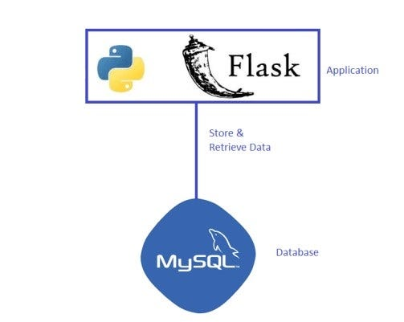
Frontend

Slide 12
Database Model Relationships
How database models are interrelated each others

Slide 13
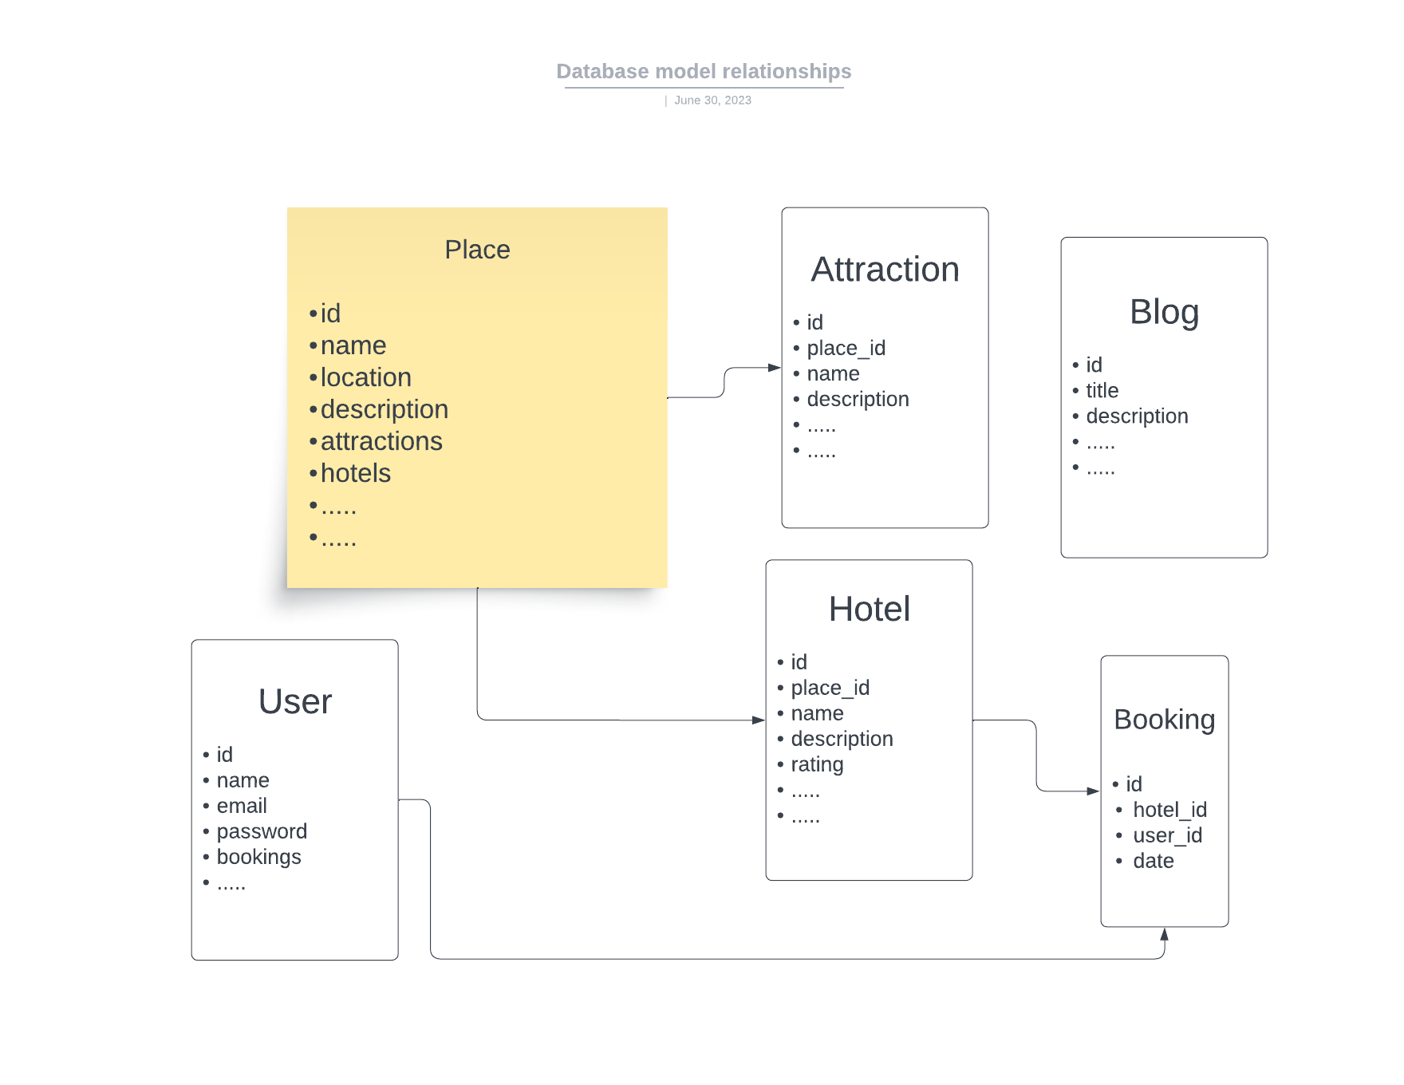

Slide 14
Thank You So Much
Sincerely thanks for reviewing our project with attention.

